Slide 1
IBM University Engagement Project Submission
“Exploring the Power of Machine Learning with IBM Cloud”

Slide 2

Project Tile – College admission agent
Domain of Project – Education
Student Name | Recent Passport Photo | Email ID | Mobile number [WhatsApp]
Chetan Chaudhari |  | chaudhari.chetan1472@gmail.com | 8329160047

Slide 3
Problem Statement -
House price predictor AI
Accurately predicting real estate valuations is difficult due to the complex, non-linear interactions between disparate factors such as zoning classifications, structural age, and precise spatial metrics like basement and lot square footage. Furthermore, relying on manual data entry across fragmented systems introduces operational inefficiencies, making it challenging to deliver instantaneous, reliable price estimations while handling missing or inconsistent property attributes.

Slide 4
Proposed Solution -
The proposed solution implements an automated, end-to-end House Price Predictor deployed via IBM watsonx Orchestrate to streamline real-time property valuation workflows. By leveraging digital workers and pre-configured skills, the system automatically ingests key structural parameters—such as MSZoning, LotArea, OverallCond, YearBuilt, YearRemodAdd, and TotalBsmtSF—and routes them through a high-performance machine learning model. This approach eliminates manual data handling by enabling users to trigger highly accurate SalePrice estimations dynamically through conversational AI or automated workflows, effectively optimizing decision-making in real estate management and property assessment.

Slide 5
Technology Used
IBM Cloud – It provides the infrastructure to build, deploy, and scale the Nutrition Agent efficiently. IBM Cloud enables a reliable, secure, and scalable environment for deploying the Nutrion agent
ML Algorithm/ Model Used: Snap boosting machine regressor
Accuracy Obtained: 0.979
Enhancements and Hyperparameter tuning: HPO-1, FE, HPO-2,

Slide 6
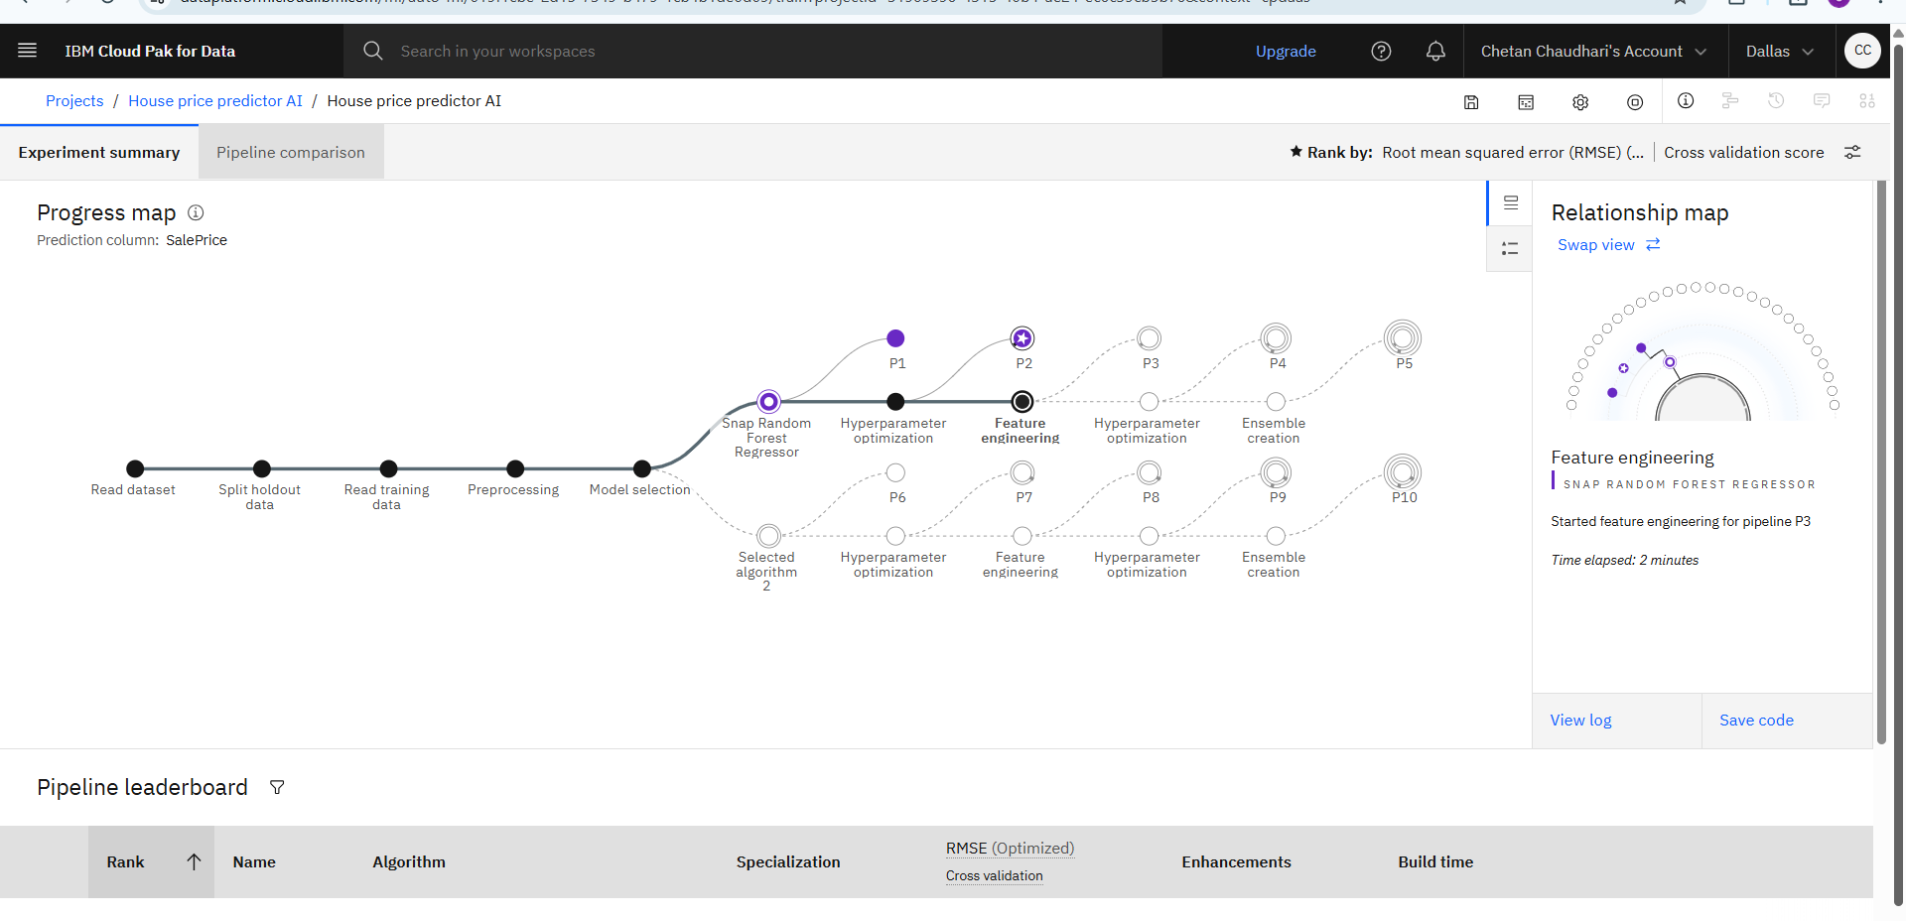
Training Screenshots-

Slide 7
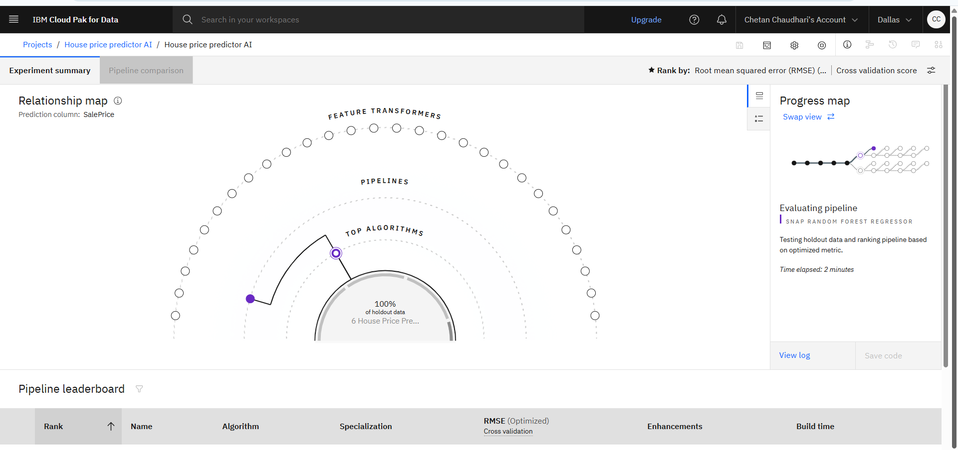
Training Screenshots-

Slide 8
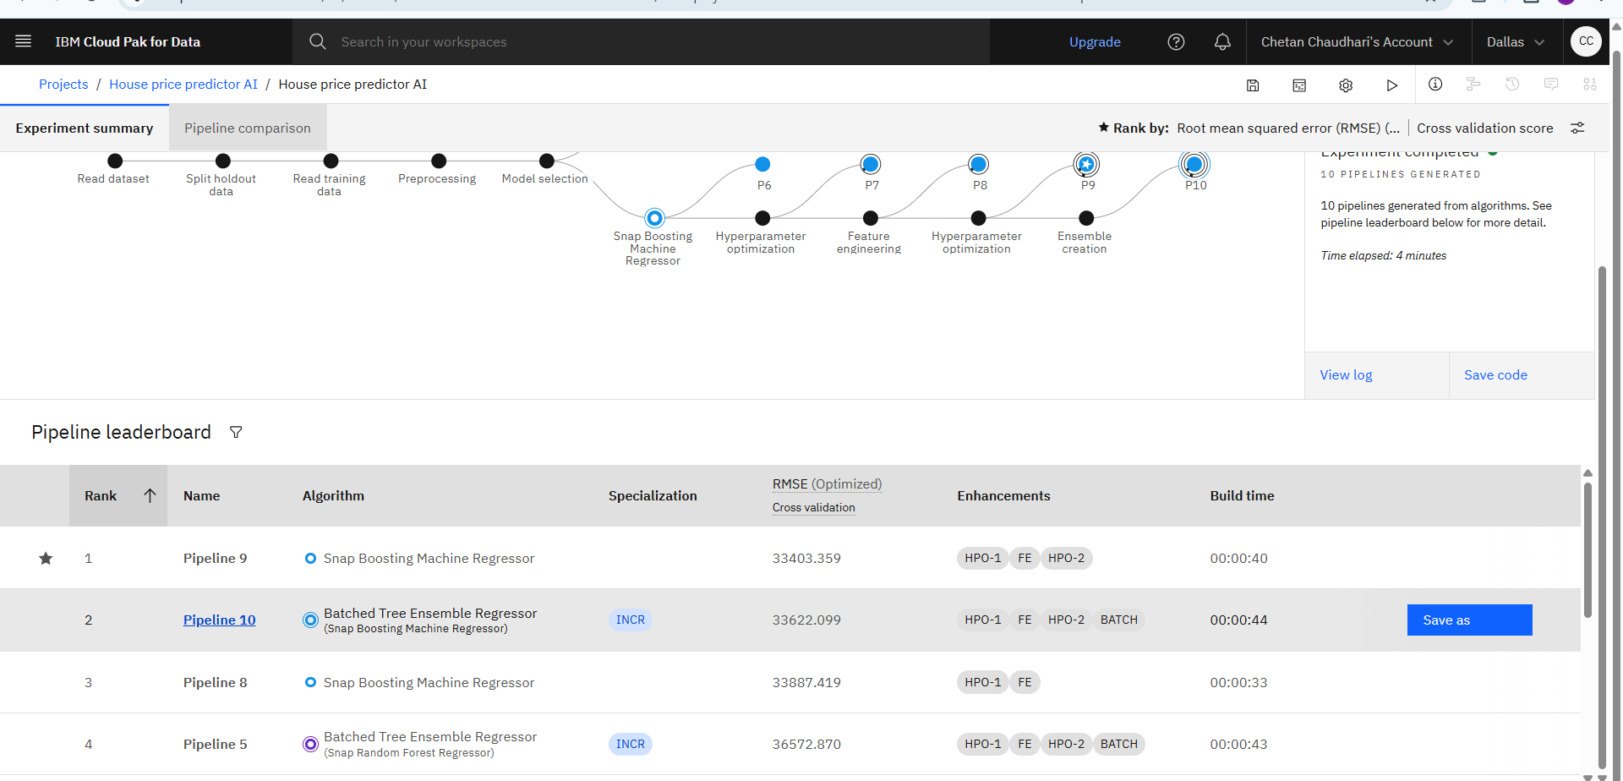
Best Model Screenshot:

Slide 9
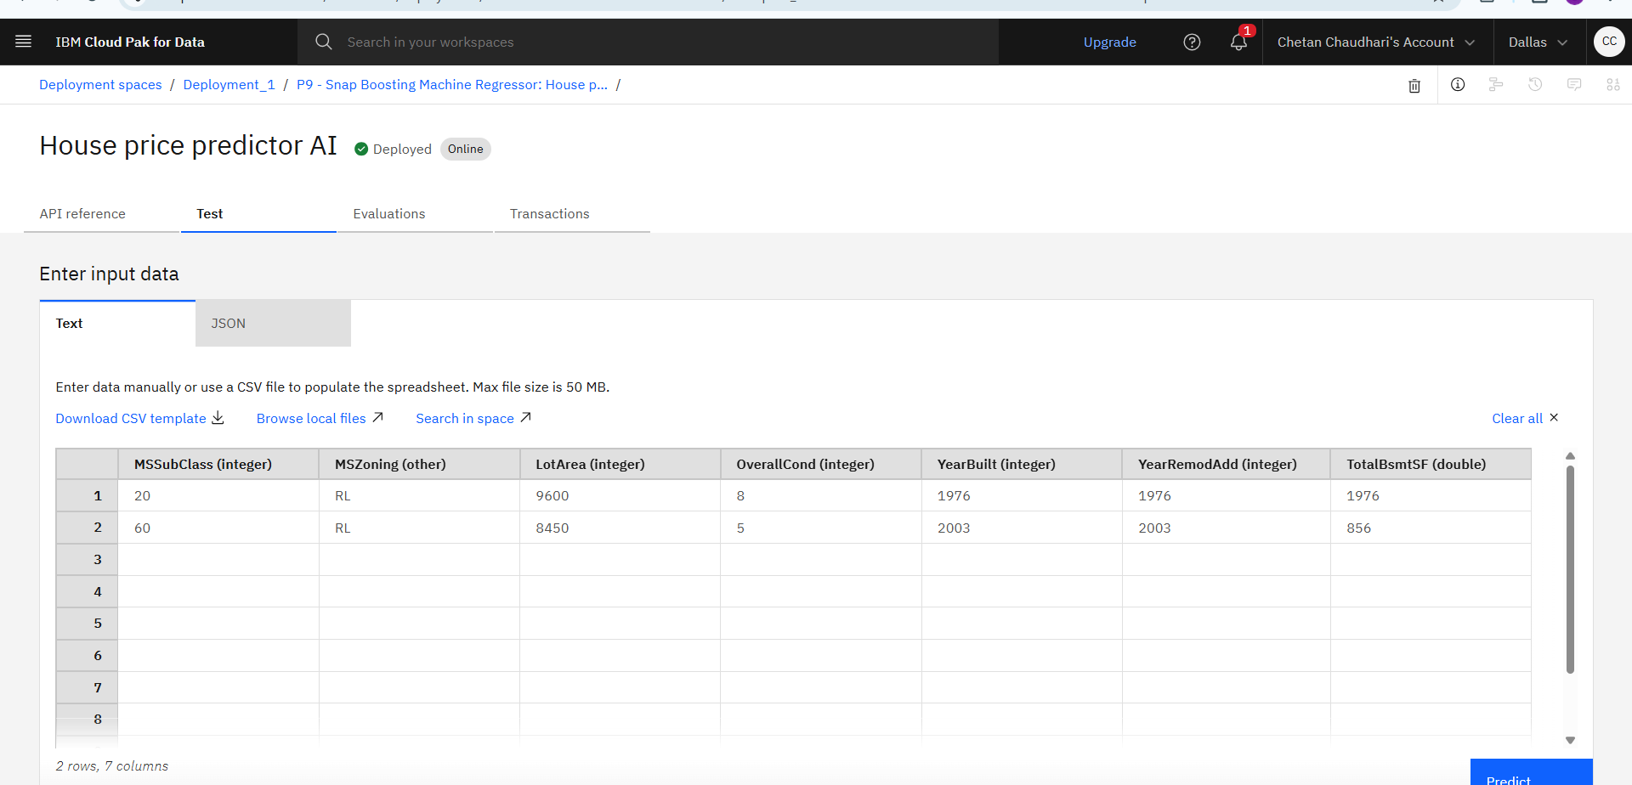
Testing Screenshot:

Slide 10
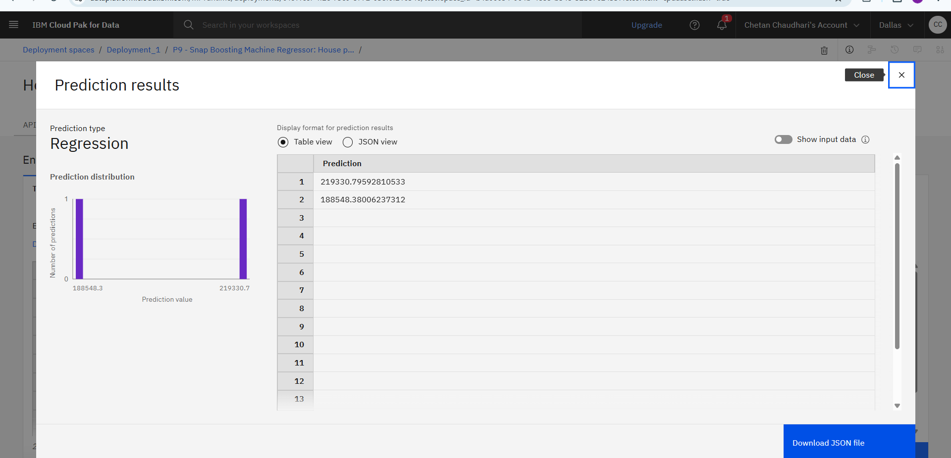
Testing Screenshot:

Slide 11
Testing Screenshot:

Slide 12
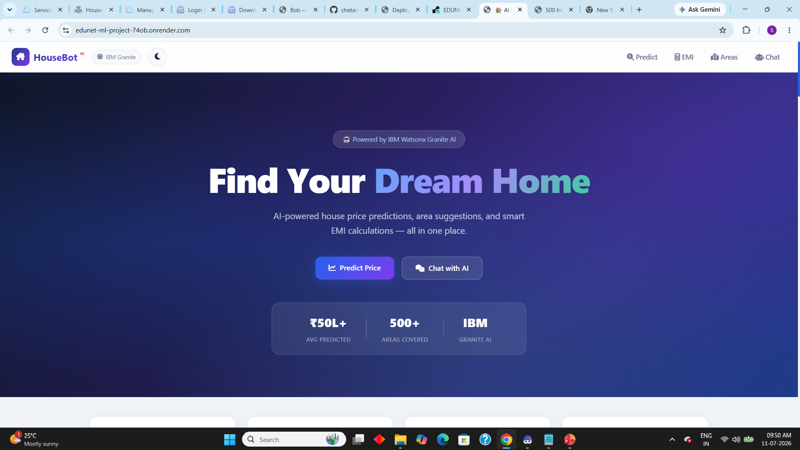
DEPLOYMENT
LINK : https://edunet-ml-project-74ob.onrender.com

Slide 13
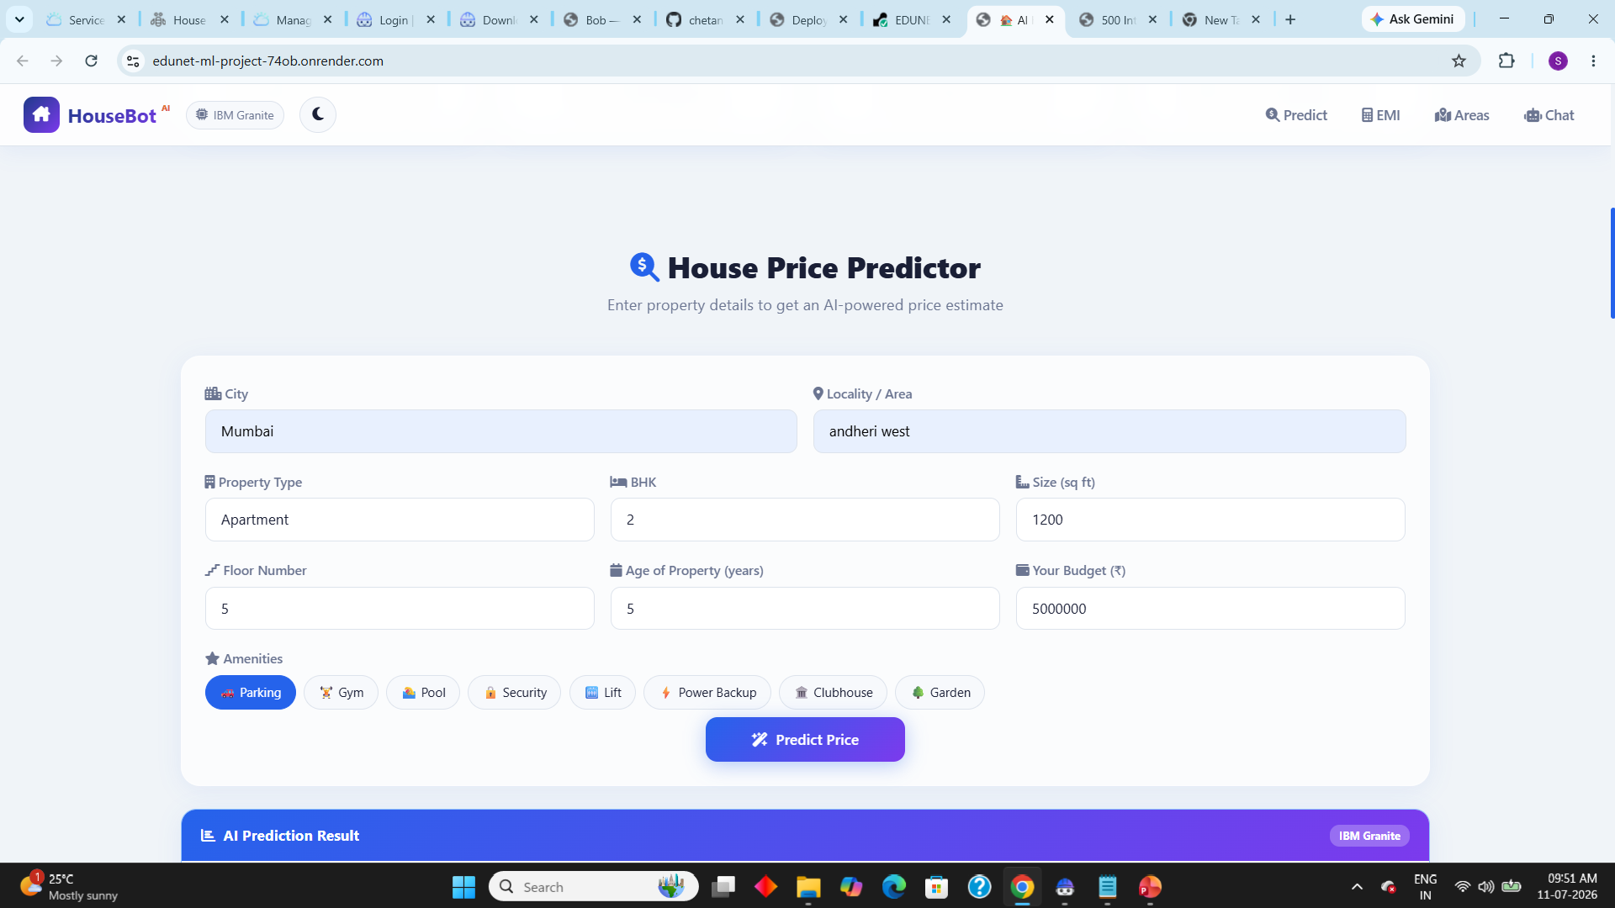
DEPLOYMENT

Slide 14
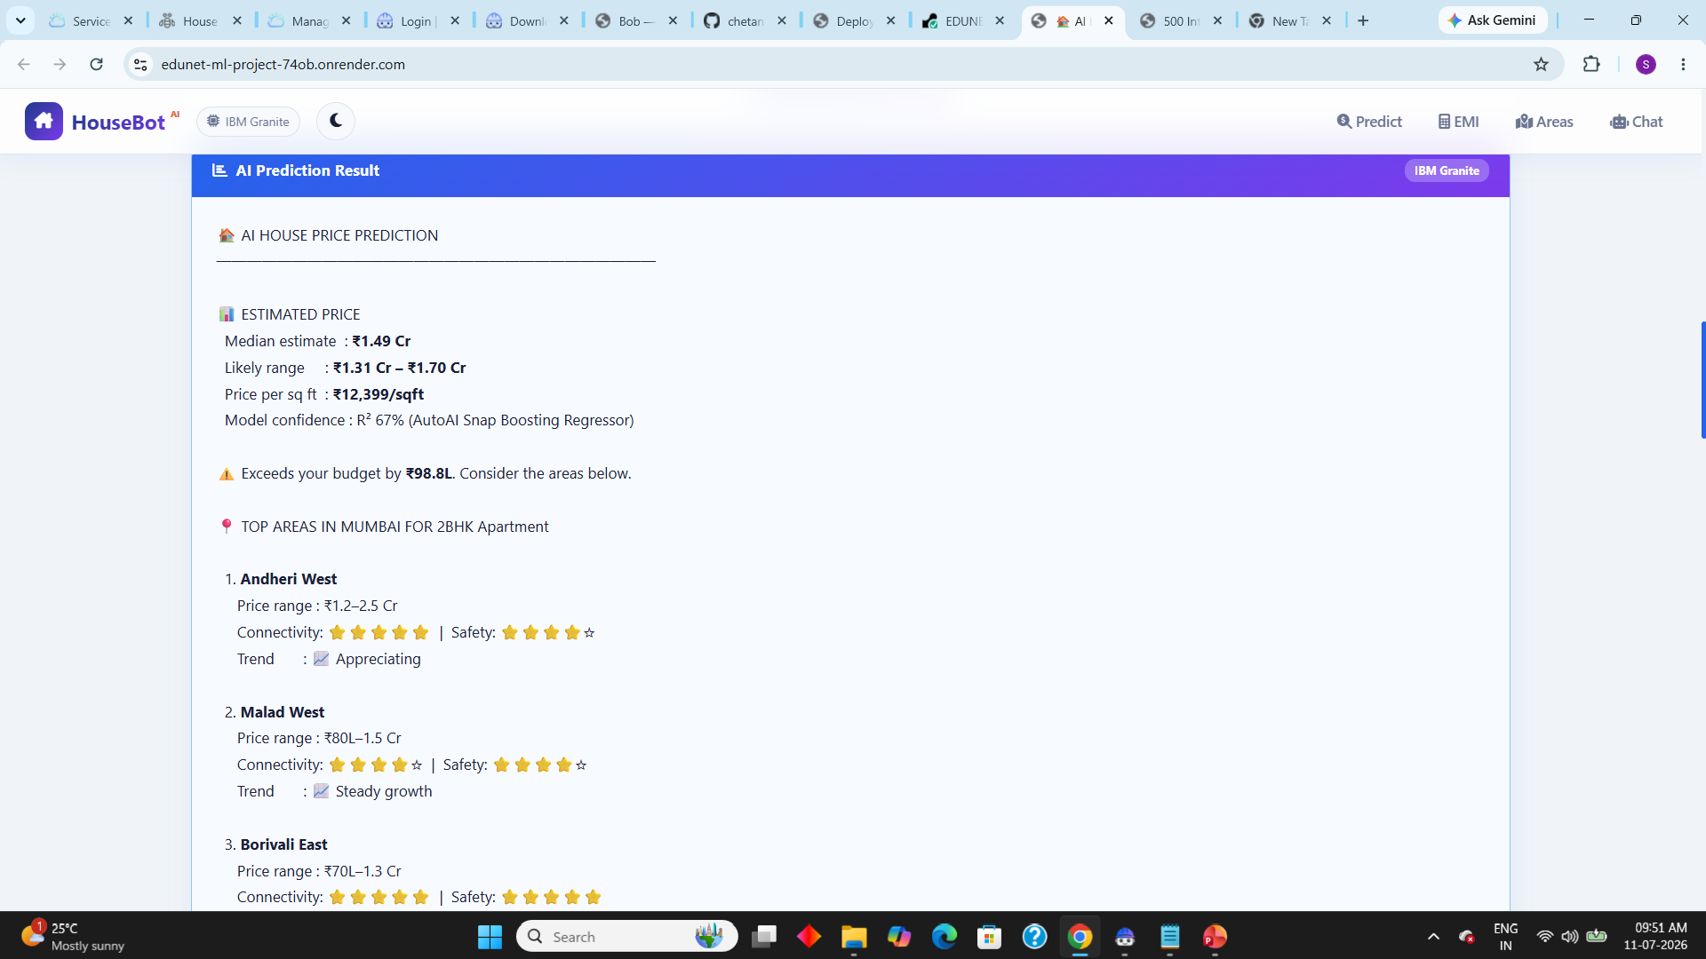
DEPLOYMENT

Slide 15
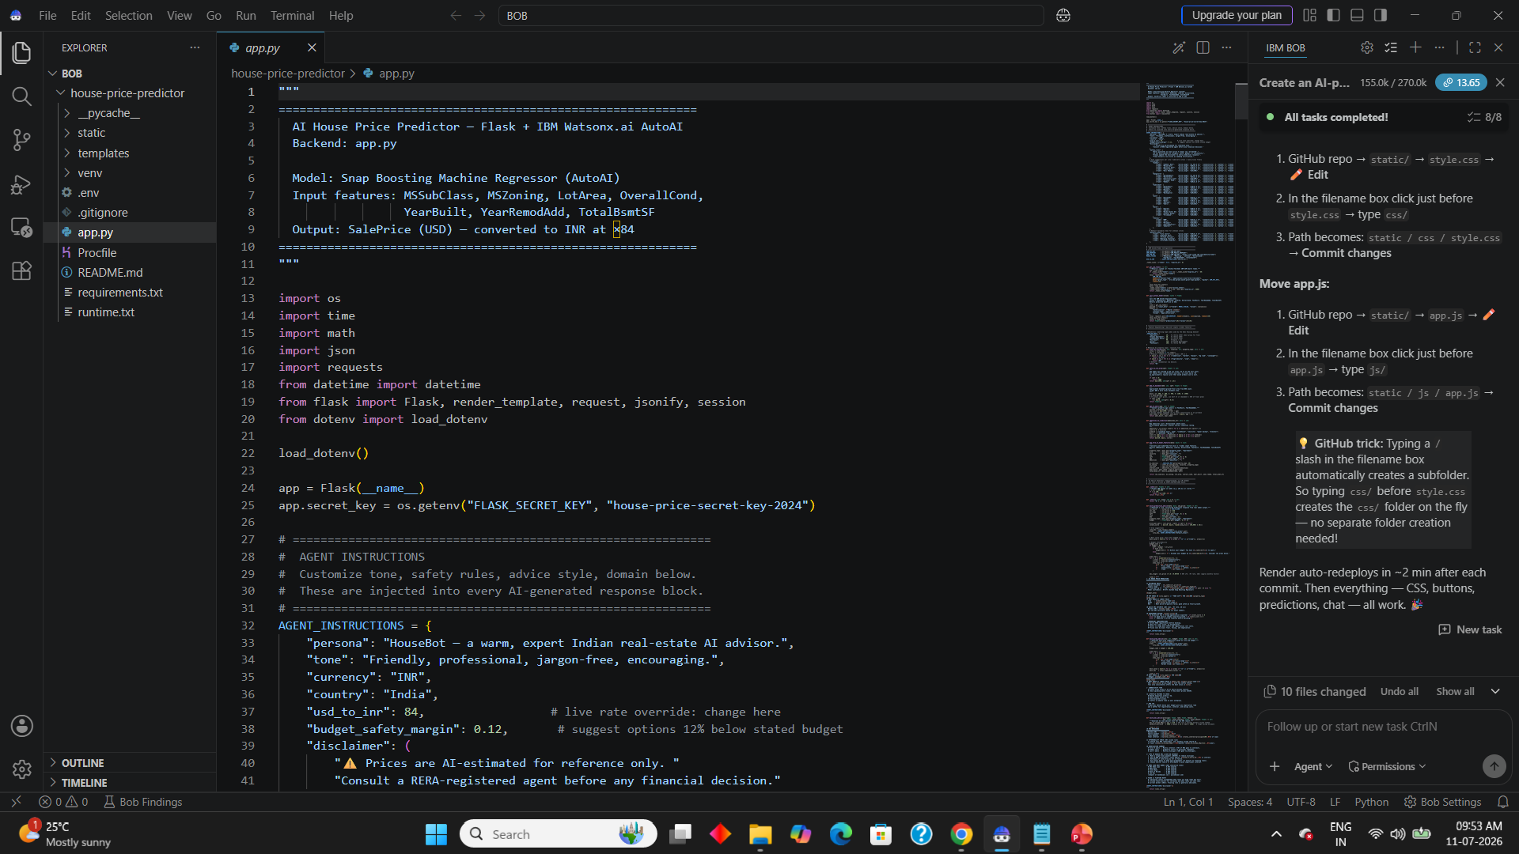
IBM BOB

Slide 16
Uniqueness
Orchestration-Driven Execution: Embeds the predictive model within an autonomous digital workforce using IBM watsonx Orchestrate, allowing predictions to be triggered seamlessly through natural language skills.
Multi-Dimensional Feature Synthesis: Simultaneously processes distinct qualitative and quantitative parameters, capturing the combined impact of zoning regulations and physical spatial metrics on market value.
Automated Operational Routing: Integrates predictive data insights directly into enterprise workflows, removing the communication gaps and inefficiencies associated with standalone ML scripts.
Temporal Depreciation Analytics: Evaluates the specific relationship between original construction dates and remodeling years to precisely adjust asset depreciation and modern updates.
Reusable Skill Packaging: Converts the complex machine learning model into a plug-and-play enterprise skill that can be readily adopted by broader systems like banking or mortgage underwriting.

Slide 17
Git Hub Link
GITHUB : https://github.com/chetan1472/EDUNET-ML-PROJECT
DEPLOYMENT LINK : https://edunet-ml-project-74ob.onrender.com
·
·

Slide 18
Future Scope
Geospatial and GIS Integration: Incorporating live geographical mapping and spatial data to analyze neighborhood trends, proximity to infrastructure, and environmental factors.
Dynamic Market Volatility Adjustments: Fetching live economic indicators, interest rate fluctuations, and inflation indexes to adjust the predictive output according to real-time market shifts.
Automated Document Intake: Utilizing advanced OCR (Optical Character Recognition) skills to extract property specifications directly from uploaded land deeds or architectural blueprints.
Computer Vision Enhancements: Integrating image classification models to assess a property's condition rating directly from uploaded interior and exterior photographs.
Automated Mortgage Integration: Linking the pricing engine with financial APIs to provide instantaneous loan-to-value calculations and pre-approval options directly within the orchestration workflow.
·
·
·

Slide 19
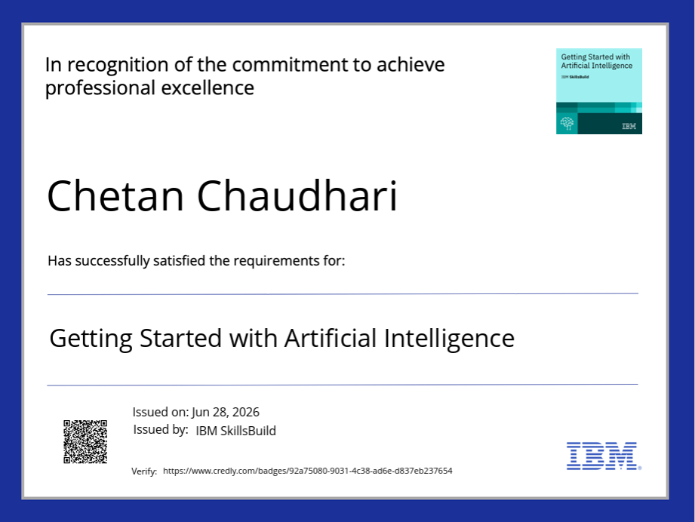
Certificates Earned:

Slide 20
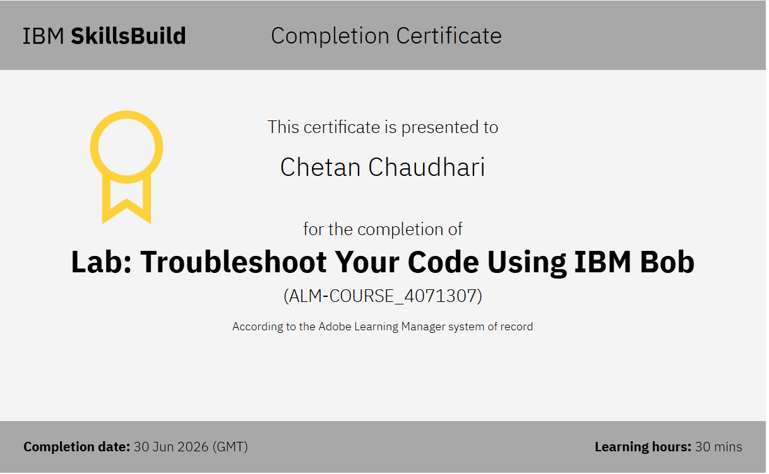
Certificates Earned:​

Slide 21
STUDENT DETAILS
Name : Chetan Chaudhari
Email : chaudhari.chetan1472@gmail.com
AICTE ID : STU6a300cd5e925d1781533909

Slide 22


